Slide 1
Final Presentation
FEED DEAD BEEF

Slide 2
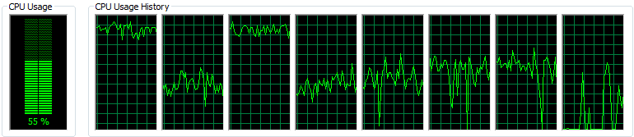
Requirement 3.1.1 and 3.1.2
3.1.1 - The system will simulate a multi-core cache/scratchpad
3.1.2 - The system will simultaneously run a scratchpad simulation and a cache simulation each time it is run

Slide 3
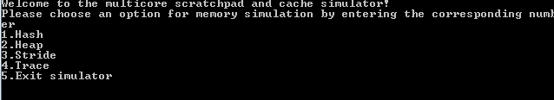
Requirement 3.1.3
The user will chose what kind of simulation they would like to run by entering a 1, 2, 3, 4, or 5 which each correspond to a type of a simulation or exiting

Slide 4
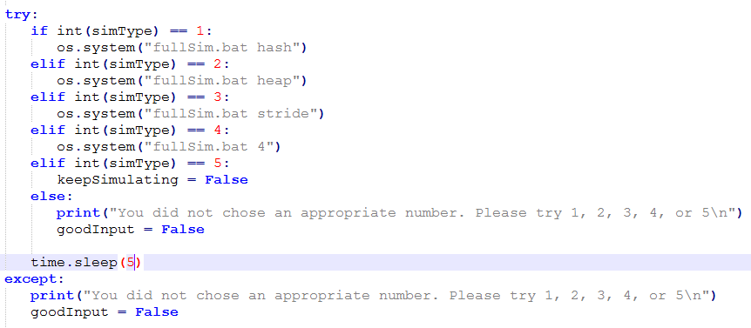
Requirement 3.1.4
The system will check to ensure the user enters correct data and it will prompt the user to try again if the data is incorrect

Slide 5
Requirement 3.1.5
The system will run the same type of simulation on both cache and scratchpad memory

Slide 6
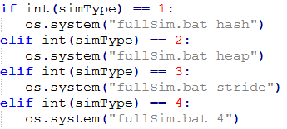
Requirement 3.1.6
The user will have four different ways to simulate the memories: hash, heap, stride, and trace

Slide 7

Requirement 3.1.7.x
3.1.7 - The predefined trace file that can be used to simulate the memory will be formatted in the following way: R/W<address>:<size> or i<cycles>
3.1.7.1 - R denotes a read command, W denotes a write command, and I denotes an nop command
3.1.7.2 - <address> is the location of where to read from or write to
3.1.7.3 - <size> is how much data to read or write
3.1.7.4 - <cycles> is how many cycles the system will sit and wait

Slide 8
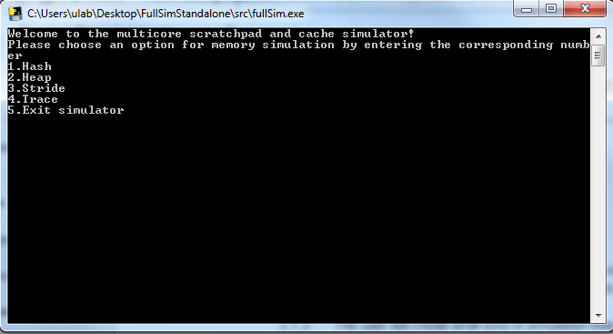
Requirement 3.2.1
The utility will be run via command line by using the executable

Slide 9
Requirement 3.2.2
The command line interface will display statistics based on the results of each simulation

Slide 10
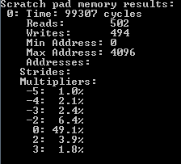
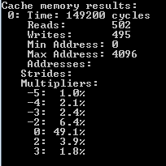
Requirement 3.2.2
Hash - A benchmark to perform random insertions and deletions of a 4-byte item in a full binary heap

Slide 11
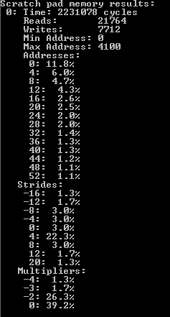
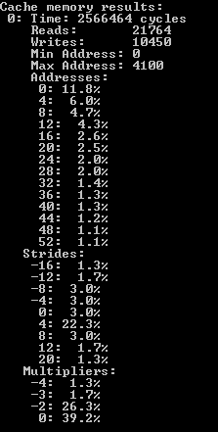
Requirement 3.2.2
Heap - A benchmark to perform random insertions and deletions of 4-byte items in a full binary heap

Slide 12
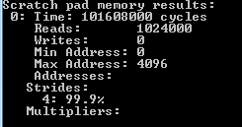
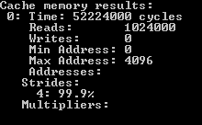
Requirement 3.2.2
Stride - A benchmark to perform strided 4-byte memory accesses

Slide 13
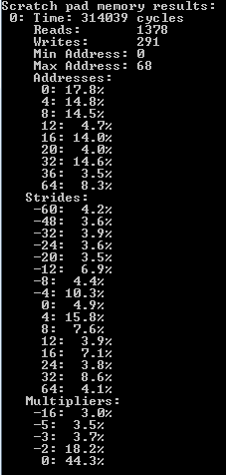
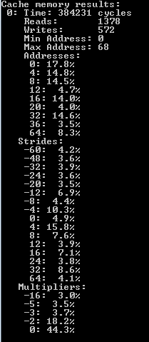
Requirement 3.2.2
Trace - A benchmark to execute a memory access trace

Slide 14
Requirement 3.3.1 and 3.3.2
3.3.1 - The utility will simulate a two core system
3.3.2 - Each simulated core will simulate one of the two memory types

Slide 15
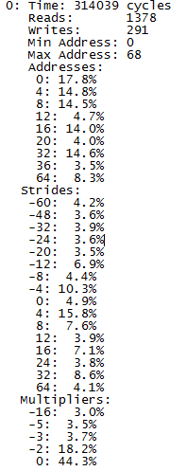
Requirement 3.3.3
After the simulations are completed the results will be displayed to the command line and respective log files

Slide 16

Requirement 3.3.4
After the simulations are completed, any errors will be displayed to the respective log files

Slide 17
Legacy Bugs
Mm simulation gives error saying “overflow check failed”
When simulation is successful, receive error saying “‘.’ is not recognized as an internal or external command, operable program or batch file.”
Does not affect outcome of simulation

Slide 18
References
J. Wingbermuehle, “Memsim,” GitHub. [Online]. Available: https://github.com/joewing/memsim. [Accessed: 18-Apr-2018].
M. Michaels, R. Craddock, M. Griffin, M. Farden, and M. Strenk, “Project Requirements,” FEED DEAD BEEF: Requirements. [Online]. Available: https://docs.google.com/document/d/1JEY7TOQd7xNCFl28PoSYUidej0NmRmL8IrEXpDCrf4Y/edit. [Accessed: 18-Apr-2018].

